Slide 1


Are you a movie lover?

Slide 2

Range 1
Name the genre

Slide 3

1
2
3
4
5
6
7
8
9
10
11
12
13
14
15
16
17
18
19
20
21
22
23
24
To Range 2

Slide 4
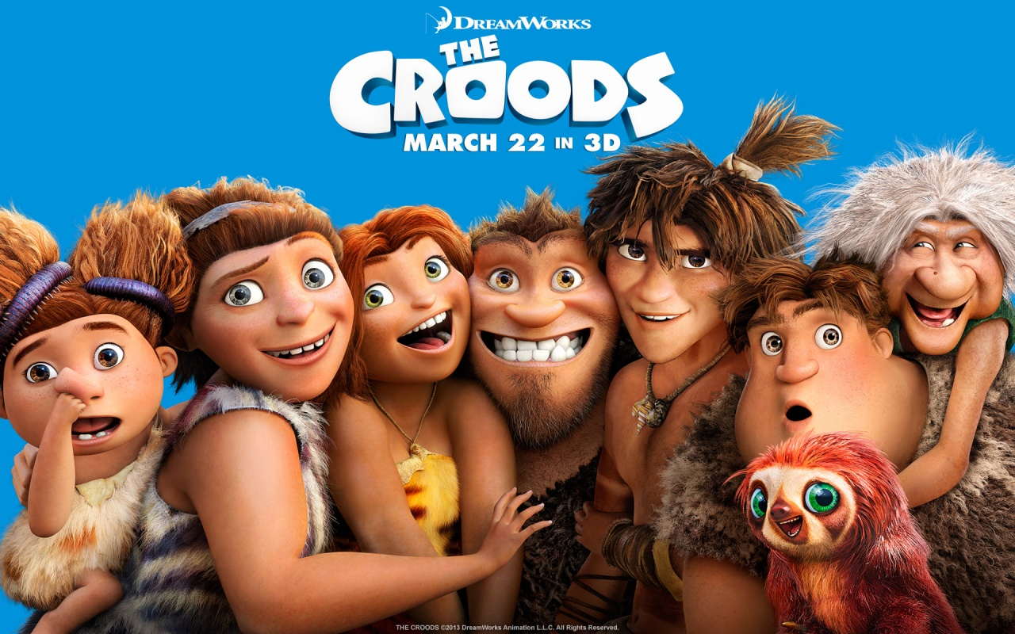
1
A cartoon

Slide 5
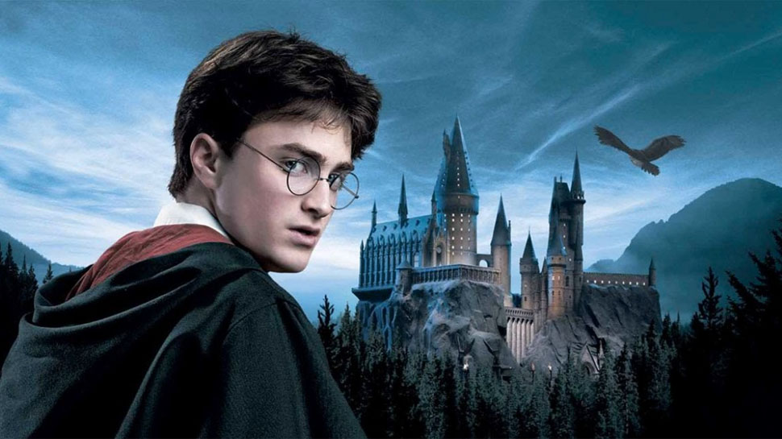
2
A fantasy

Slide 6

3
A disaster film

Slide 7
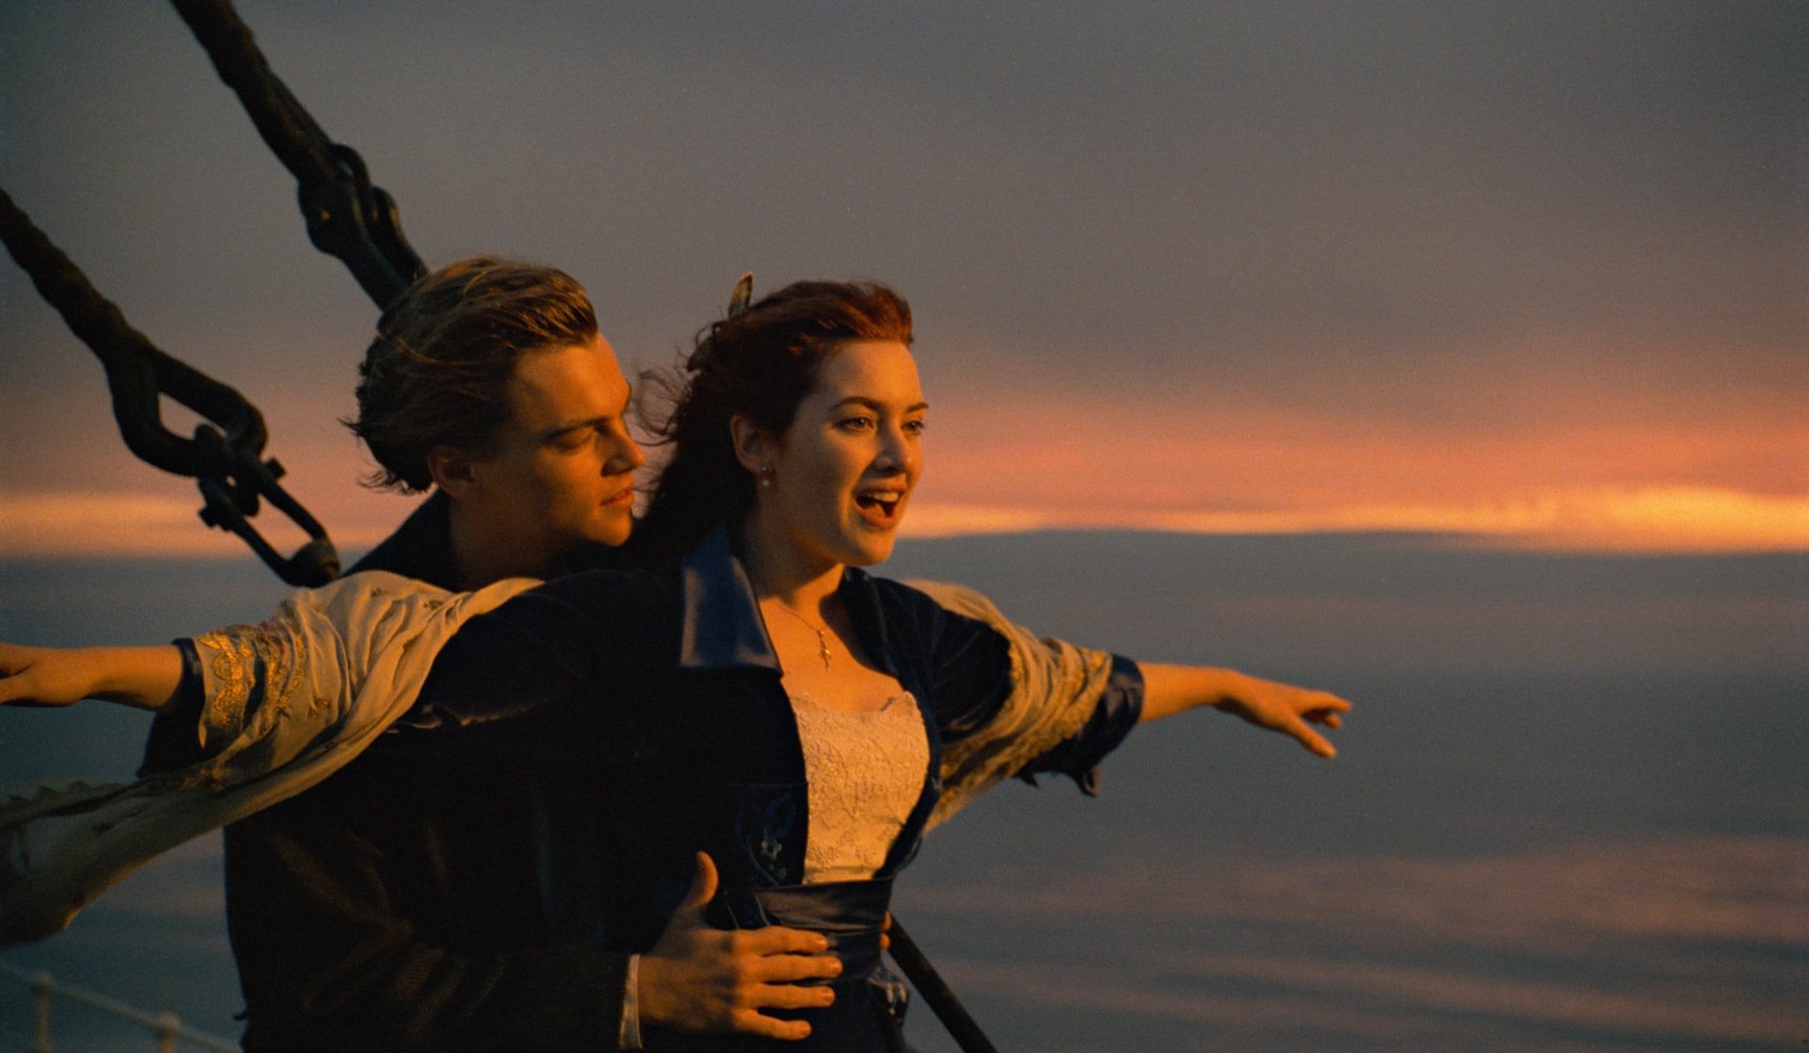
4
A drama

Slide 8

5
A comedy

Slide 9

6
A science fiction film

Slide 10

7
A thriller

Slide 11
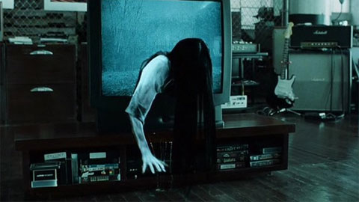
8
A horror film

Slide 12

9
An action film

Slide 13

10
A musical

Slide 14
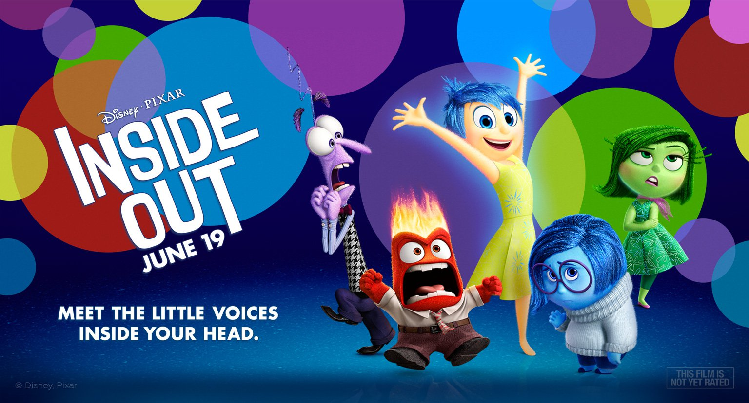
11
A cartoon

Slide 15

12
An action film

Slide 16

13
A thriller

Slide 17

14
A disaster film

Slide 18
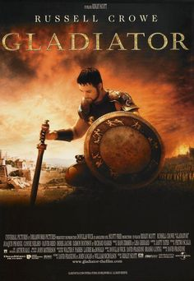
15
A historical film

Slide 19

16
An action film

Slide 20
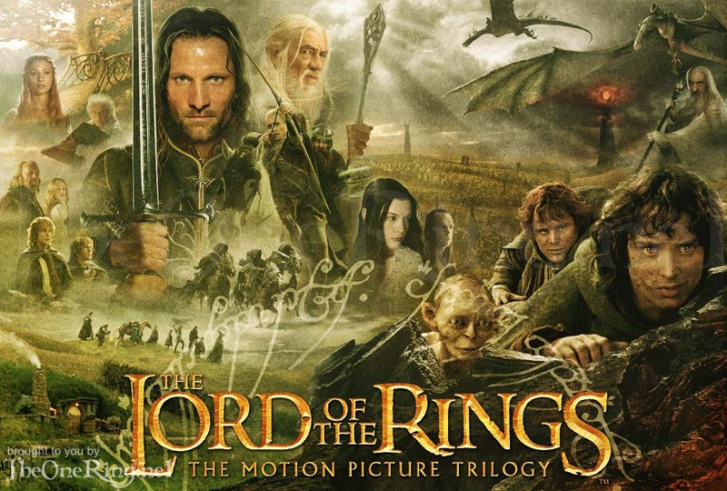
17
A fantasy

Slide 21
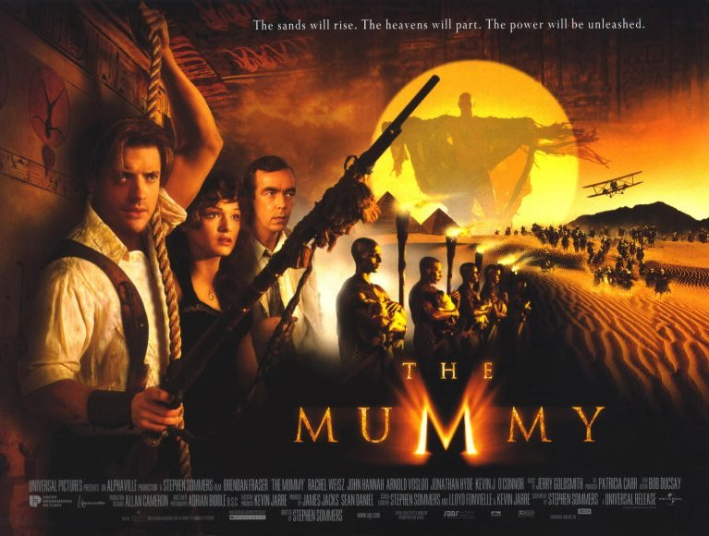
18
An adventure film

Slide 22

19
A comedy

Slide 23
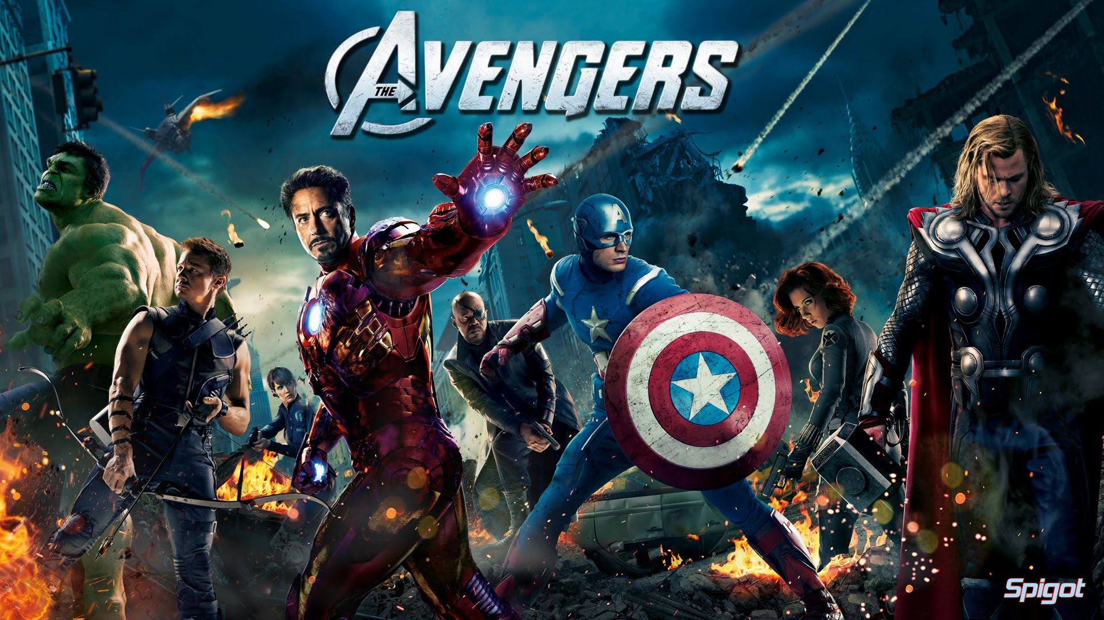
20
An action film

Slide 24
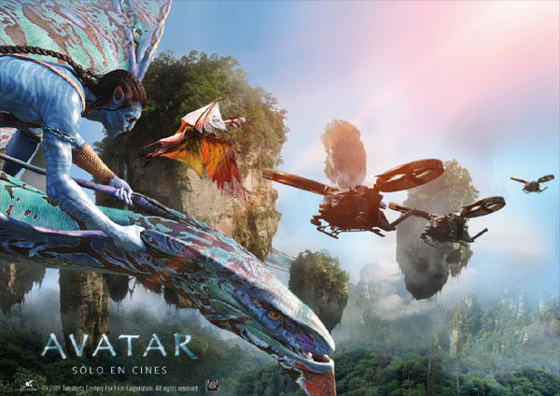
21
A science fiction film,
an action film

Slide 25

22
An action film

Slide 26
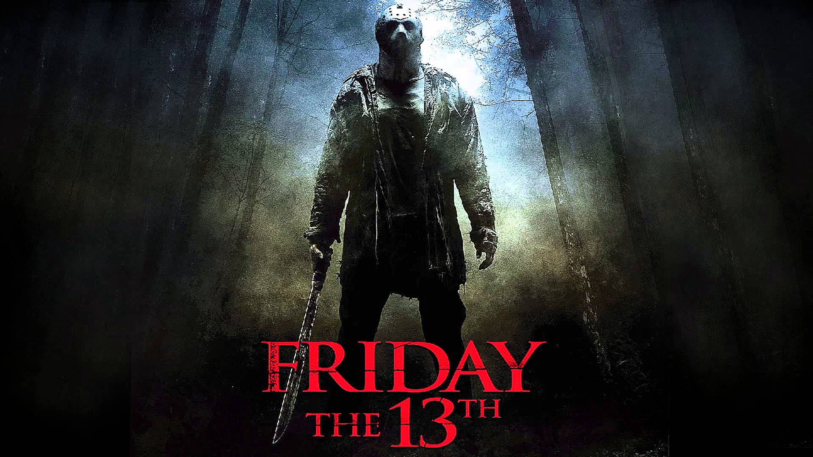
23
A horror film

Slide 27
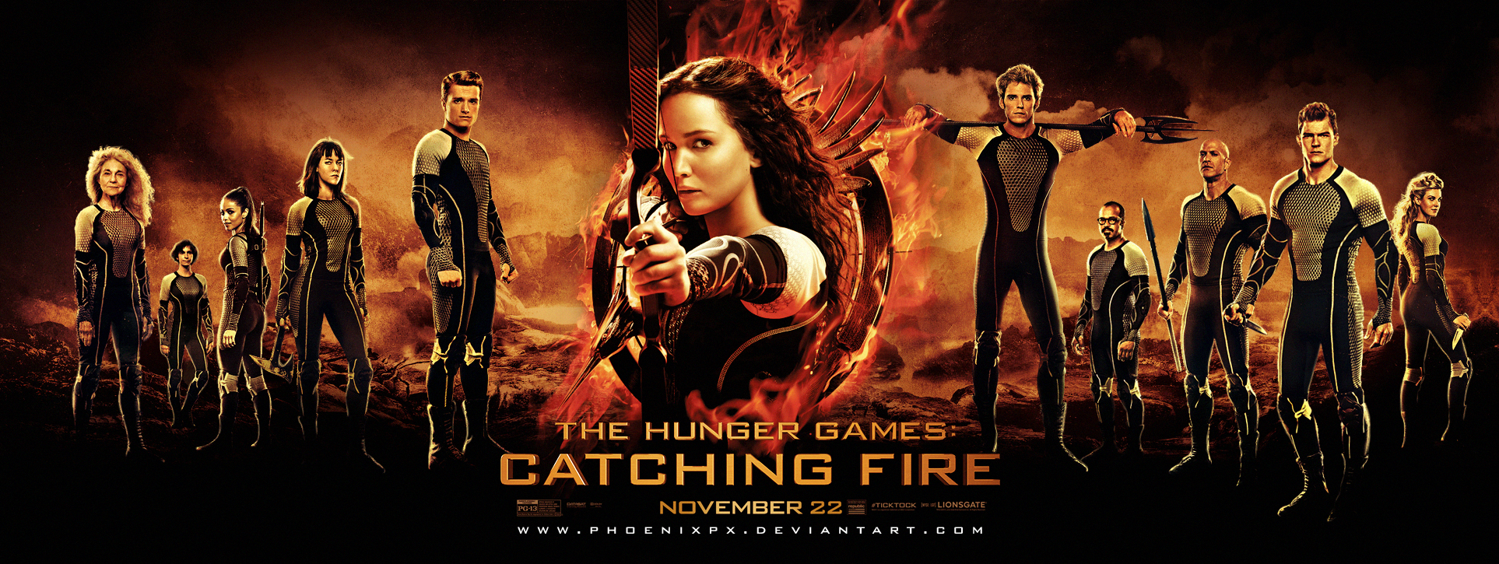
24
An action film

Slide 28
Range 2
Name the movie
and the genre

Slide 29
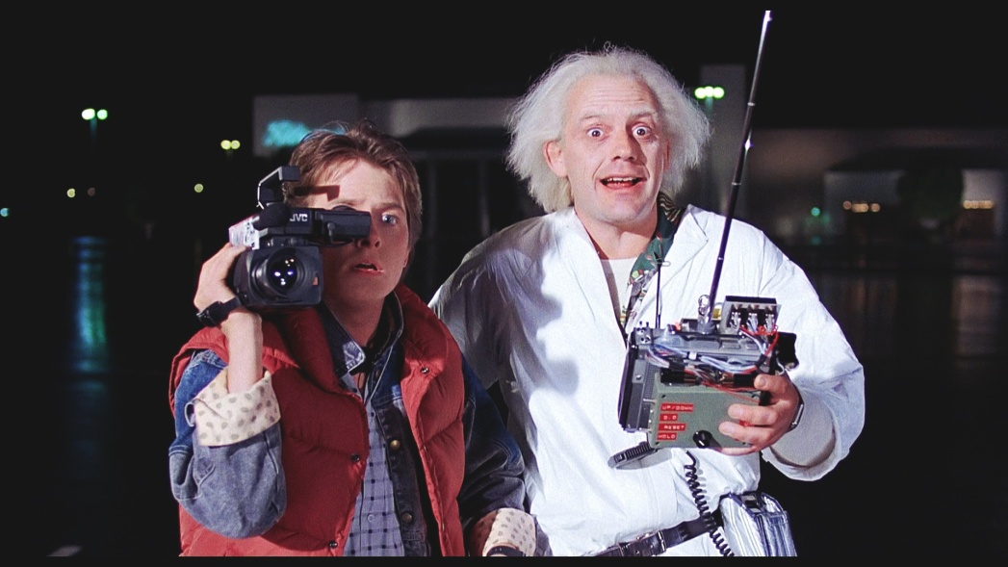
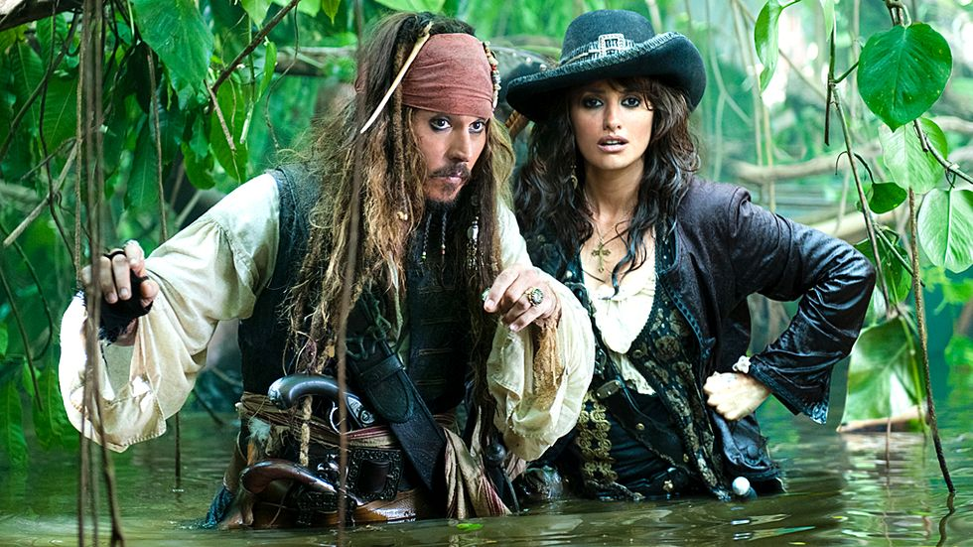
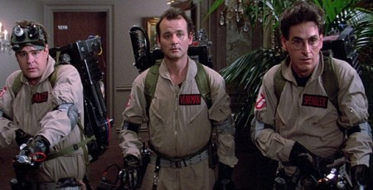
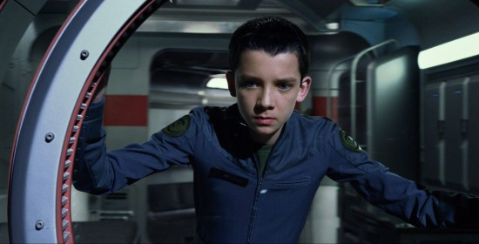
1
2
Science fiction
“Back to the future”
Adventure film
“Pirates of the Caribbean”
3
4
Science fiction
“Ghostbusters”
Science fiction
“Ender’s game”

Slide 30
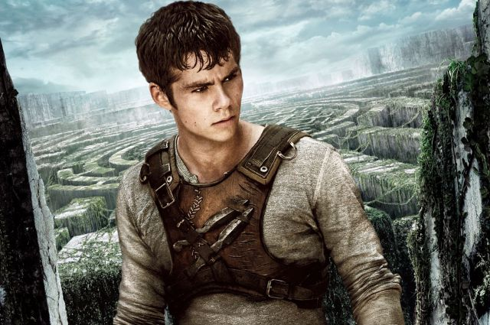
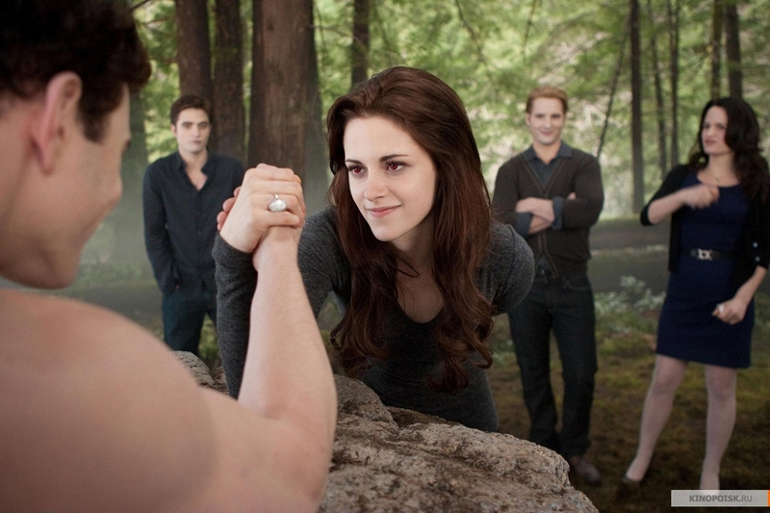
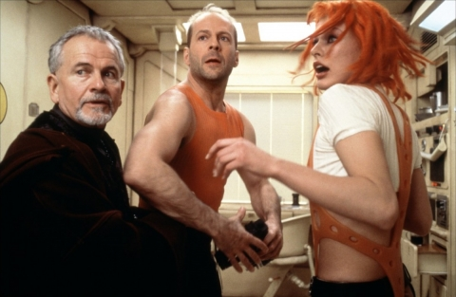
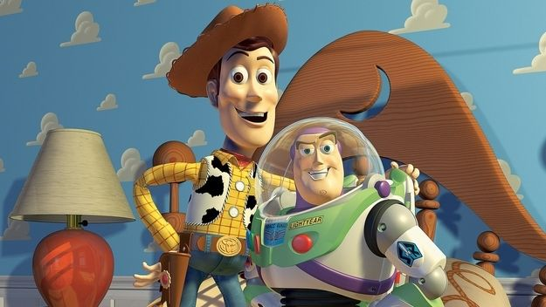
5
6
Action film
“Maze runner”
Fantasy
“Twilight”
7
8
Cartoon
“Toy story”
Science fiction
“The fifth element”

Slide 31
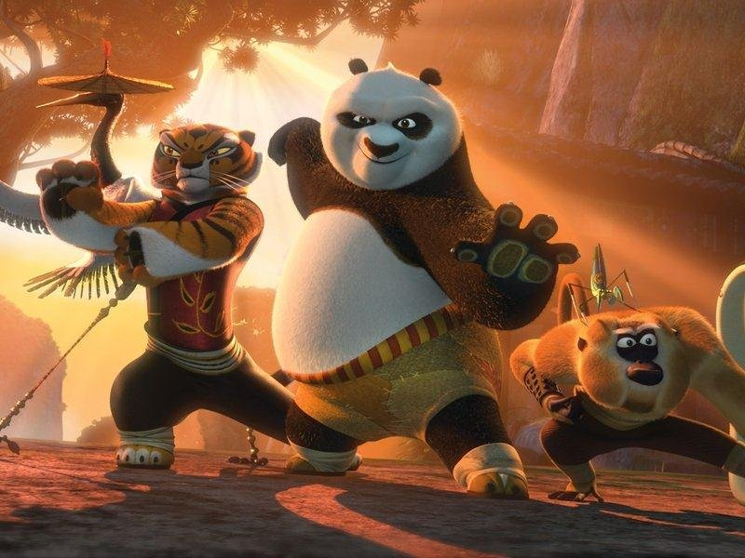
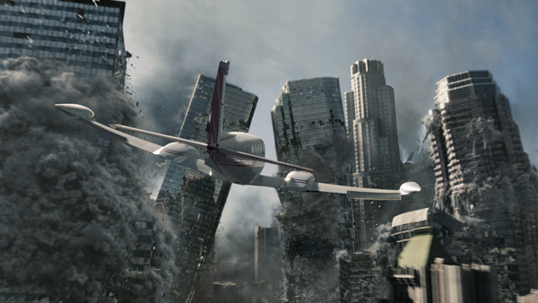
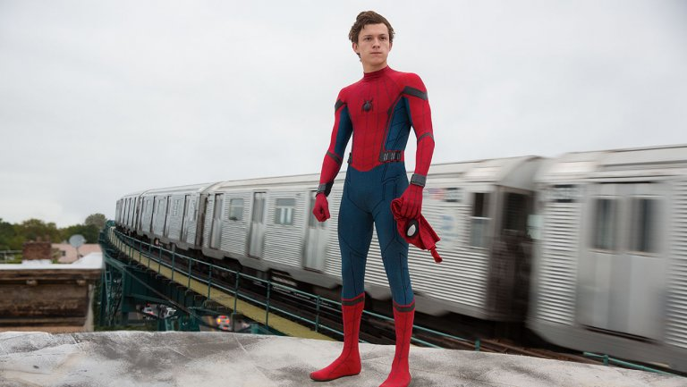
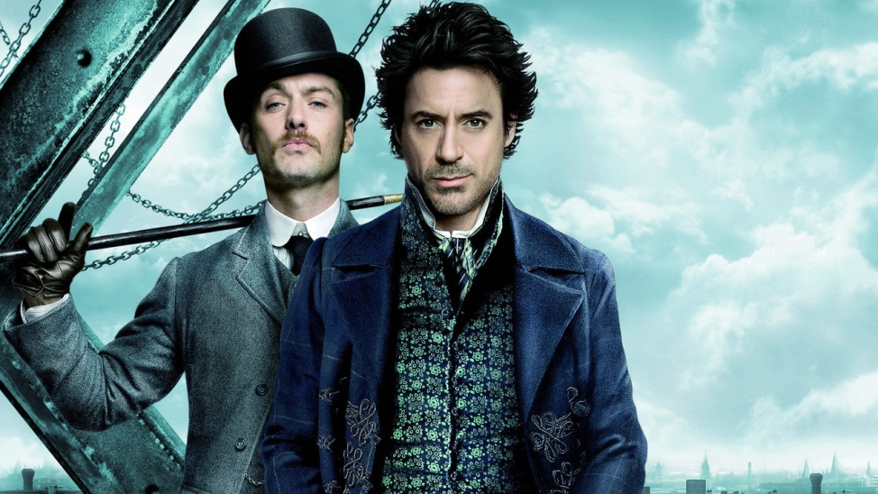
9
10
Cartoon
“Kung Fu Panda”
Disaster film
“2012”
11
12
Action film
“Spider man: Homecoming”
Detective
“Sherlock Holmes”

Slide 32
Range 3
Favourite movie pet

Slide 33
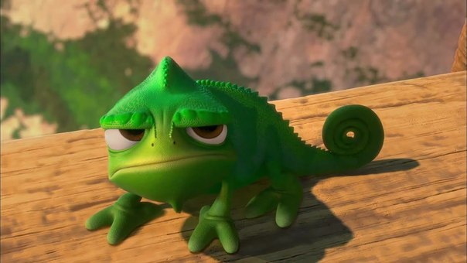
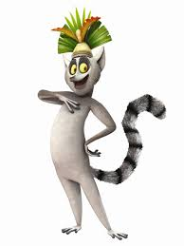
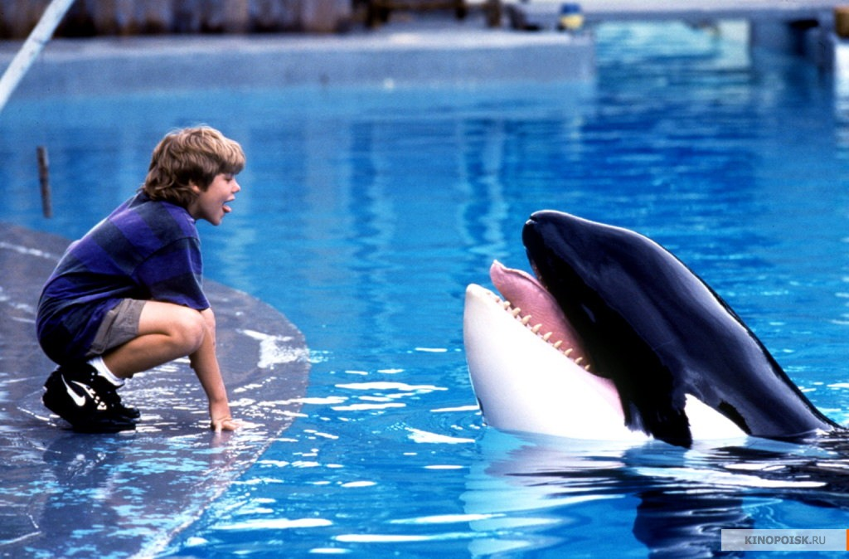
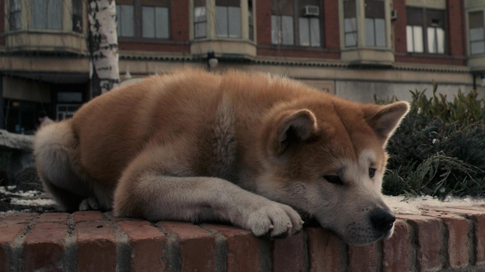
1
2
Chameleon Pascal
“Tangled” (a cartoon)
Lemur King Julien
“Madagascar” (a cartoon)
3
4
Dolphin Willi
“Free Willi” (a family film)
Dog Hatchi
“Hatchi” (a drama)

Slide 34
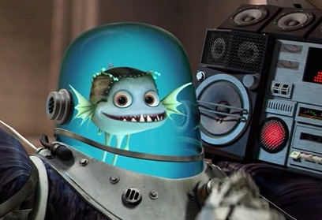
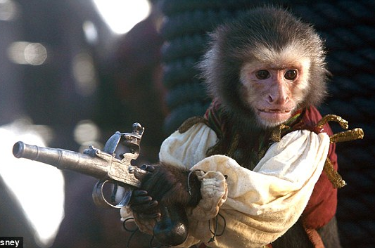
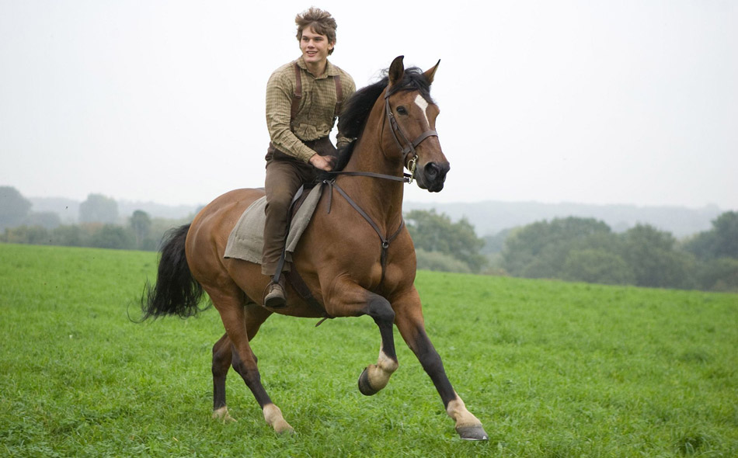
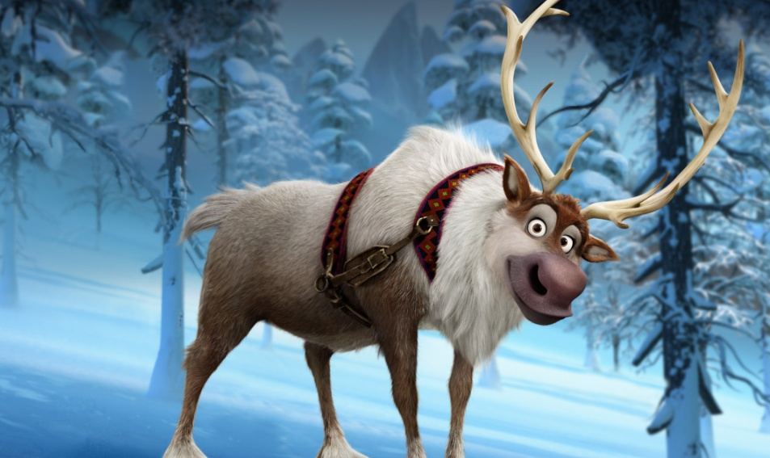
5
6
Fish Minion
“Megamind” (a cartoon)
Monkey Jack
“Pirates of the Caribbean”
(an adventure film)
7
8
Horse Thoroughbred
“War horse” (a historical drama)
Deer Swen
“Frozen” (a cartoon)

Slide 35
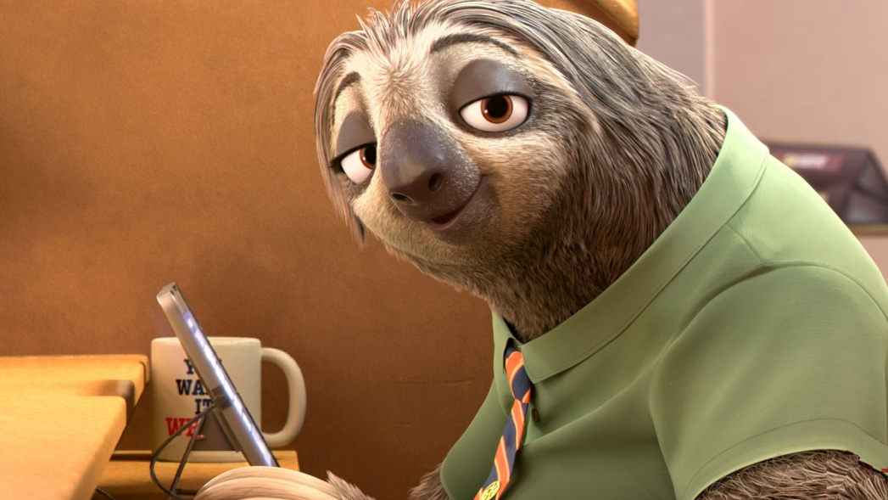
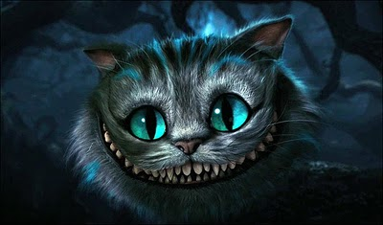
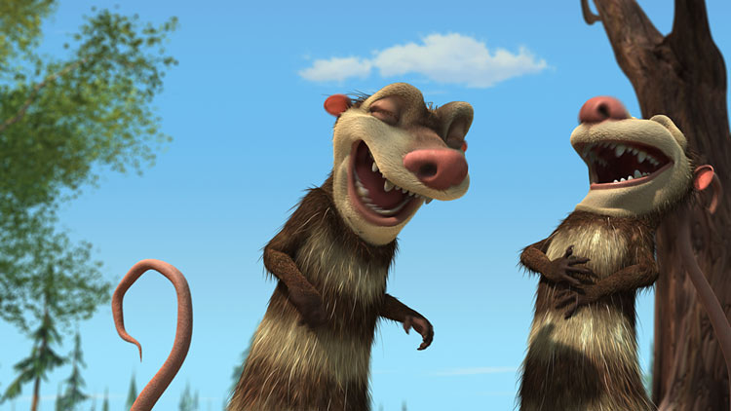
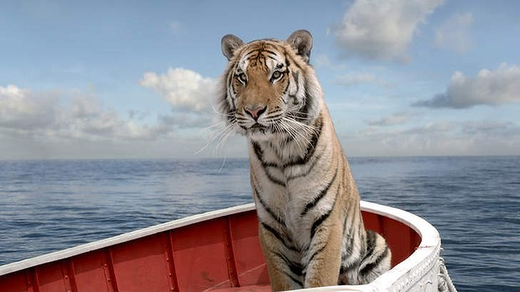
9
10
Sloth Flash
“Zootopia” (a cartoon)
Cheshire Cat
“Alice in Wonderland” (a fantasy)
11
12
Opossums Crash and Eddie
“Ice Age” (a cartoon)
Tiger Richard Parker
“Life of Pi” (an adventure film)

Slide 36

Range 4
What films do you like?

